Slide 1
Vanadium Oxide on Anatase (101)

Slide 2
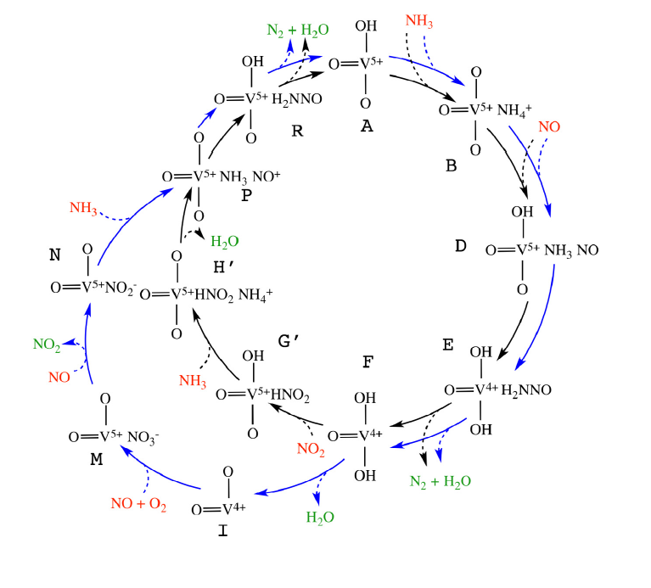

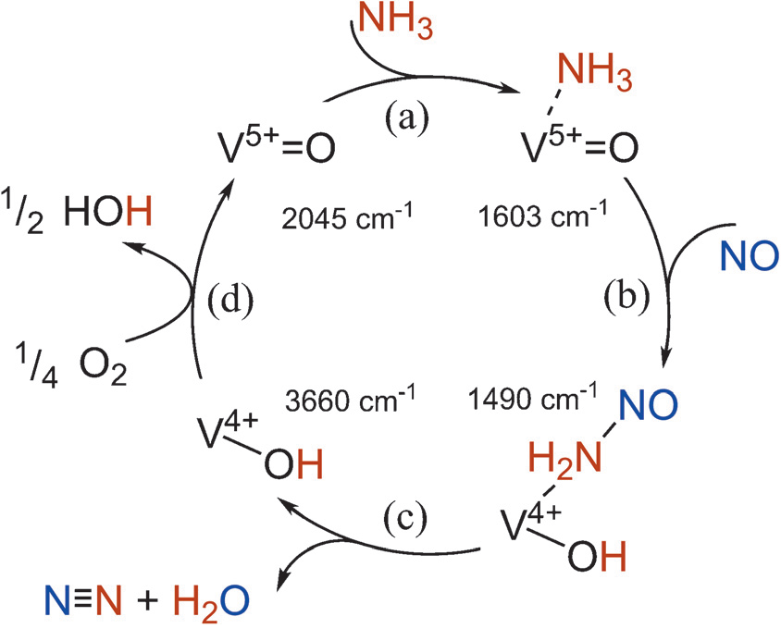
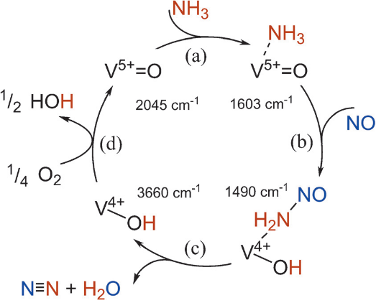
4NO + 4NH₃ + O₂ → 4N₂ + 6H₂O

Slide 3
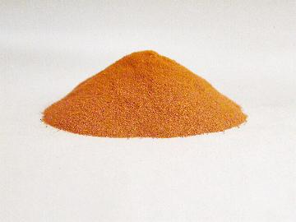
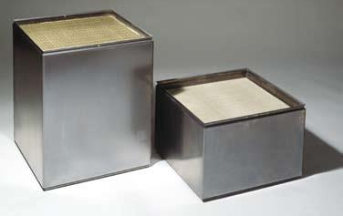
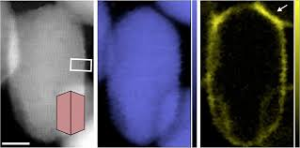
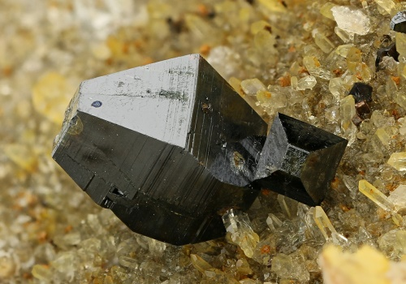
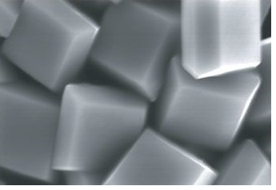
SCR-catalyst
Active phase, submonolayer-V₂O₅
Substrate, Anatase-TiO₂
(101)
(001)
YANG, Hua Gui, et al. Anatase TiO 2 single crystals with a large percentage of reactive facets. Nature, 2008, 453.7195: 638. Ek, Martin, et al. "Visualizing atomic-scale redox dynamics in vanadium oxide-based catalysts." Nature communications 8.1 (2017): 305.

Slide 4
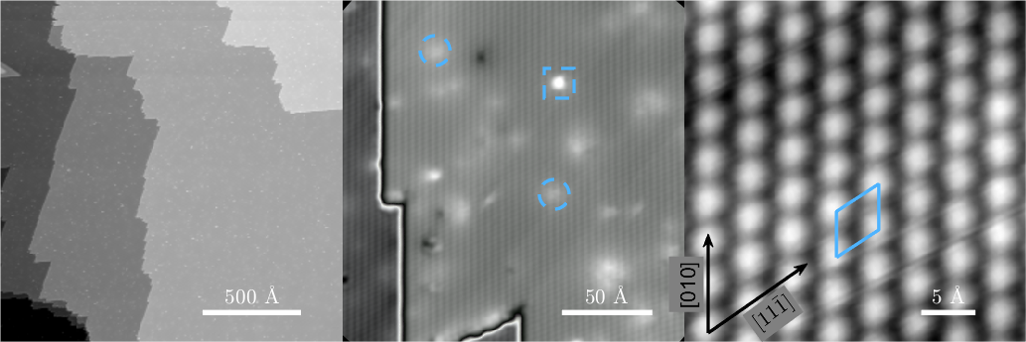
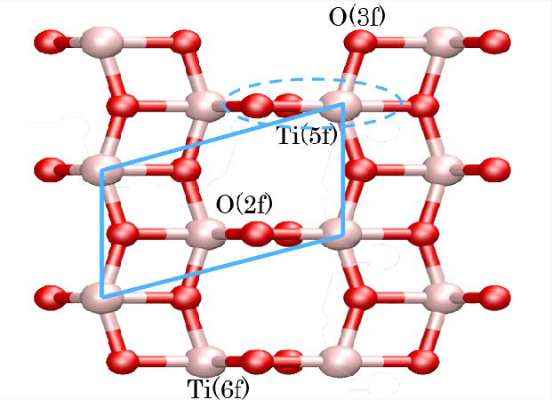
Clean anatase Tio2 (101)

Slide 5
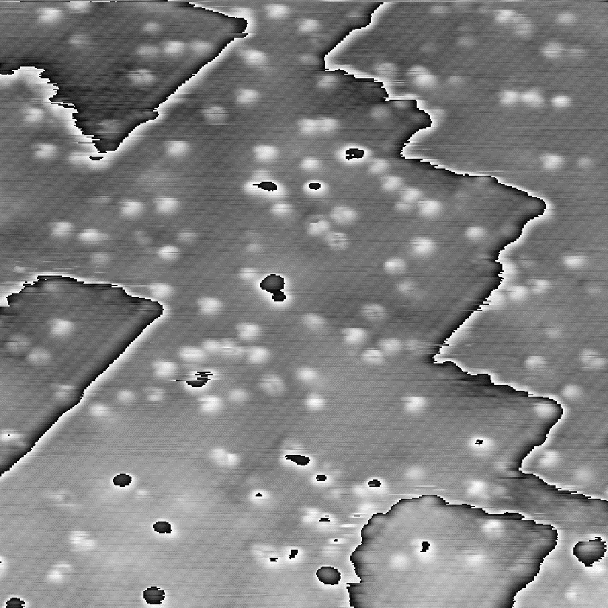
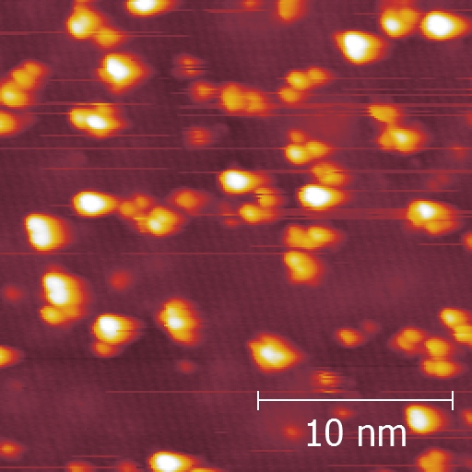
STM of V2O5 –clusters (as-deposited)
V2O5 clusters on a-TiO2
– evaporated from metal in O2
V2O5 clusters on a-TiO2
– evaporated from powder

Slide 6
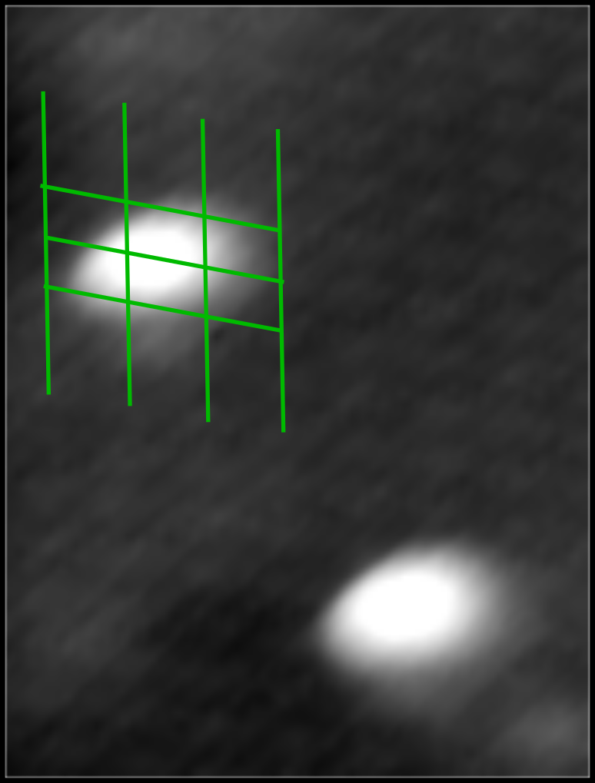
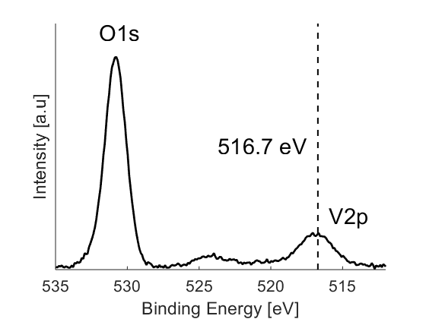
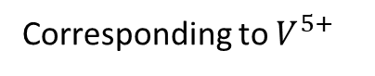
As deposited
XPS – of reactive deposition
Corresponding to $V^{5+}$
Imaged at room temperature
coverage ~ 0.5ML

Slide 7
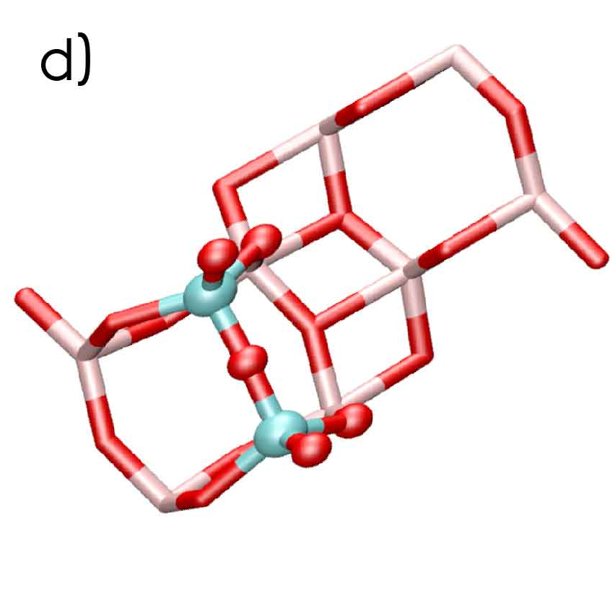


Structural models
$$VO_{x}$$
$$V_{2}O_{5}$$

Slide 8
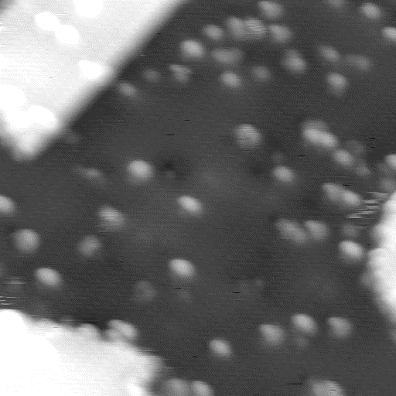
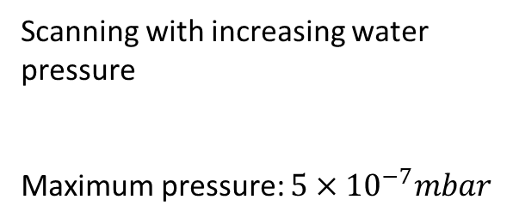
Adding water
Scanning with increasing water pressure
Maximum pressure: $5×{10}^{−7}mbar$

Slide 9
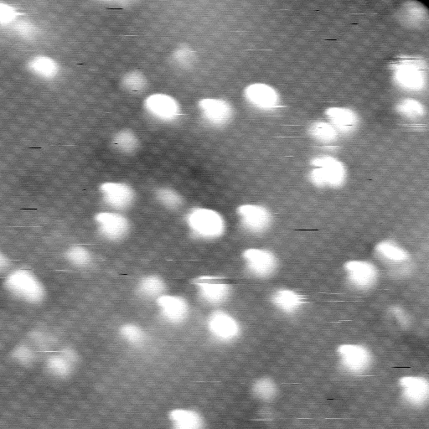
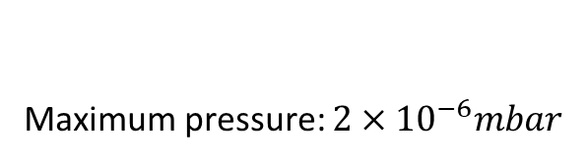
Re-exposing
Maximum pressure: $2×{10}^{−6}mbar$

Slide 10
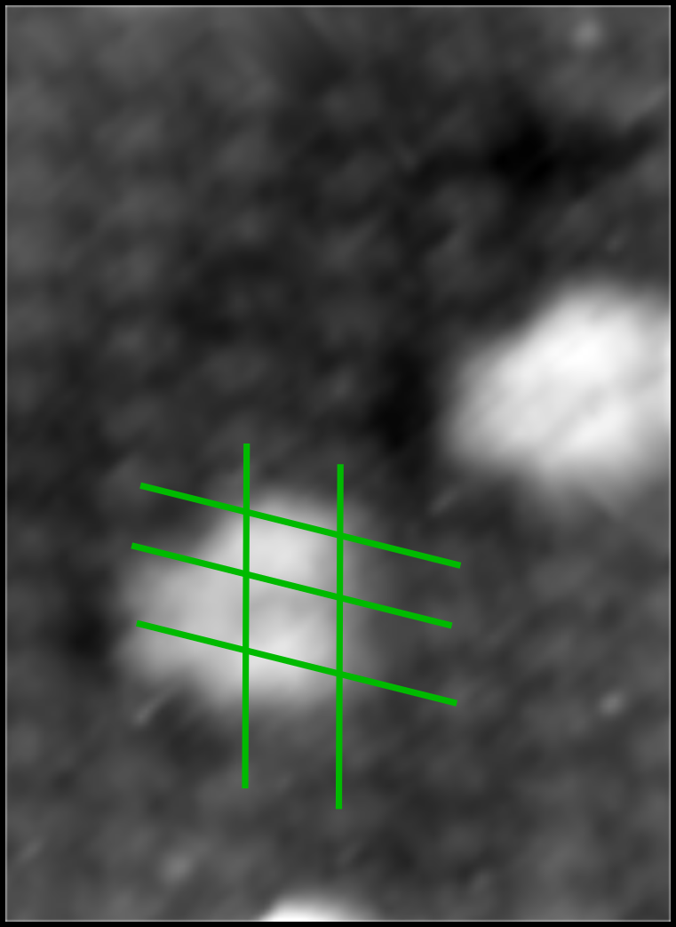
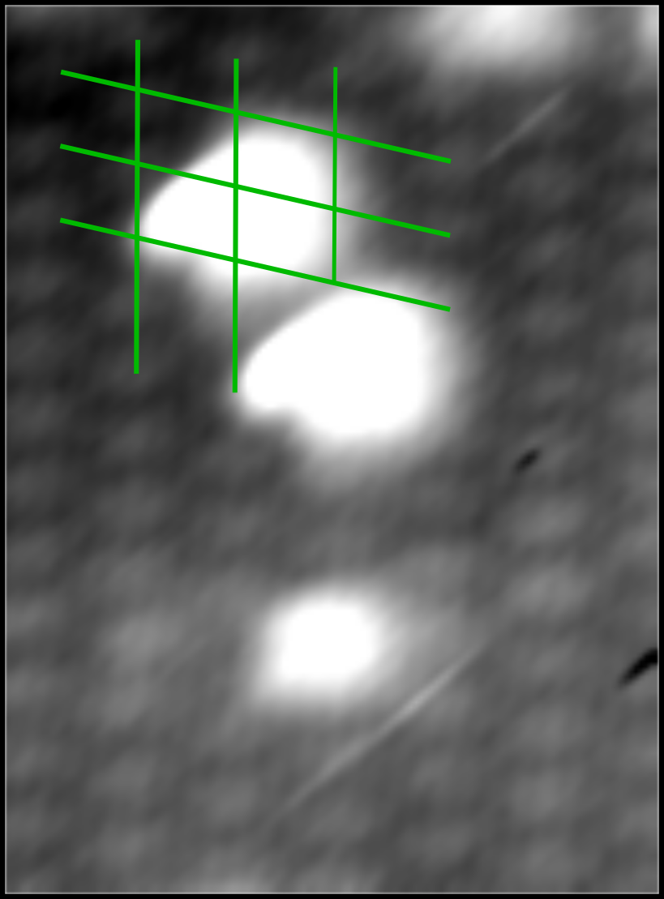
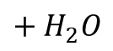
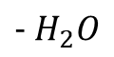
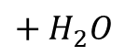
3 features are present during the experiment
Across the rows
Before water exposure
Cherry
During water exposure
Nose
After water exposure
$$+ H_{2}O$$
$$− H_{2}O$$
$$+ H_{2}O$$

Slide 11
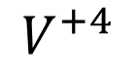
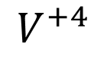
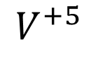
Most stable
$$V^{+5}$$
$$V^{+4}$$
$$V^{+4}$$
L. Arnarson, Lauritsen, J. V., & Moses, P. G. (2015). Coexistence of Square Pyramidal Structures of Oxo Vanadium (+ 5) and (+ 4) Species Over Low-Coverage VO X/TiO2 (101) and (001) Anatase Catalysts. The Journal of Physical Chemistry C, 119(41), 23445-23452.

Slide 13
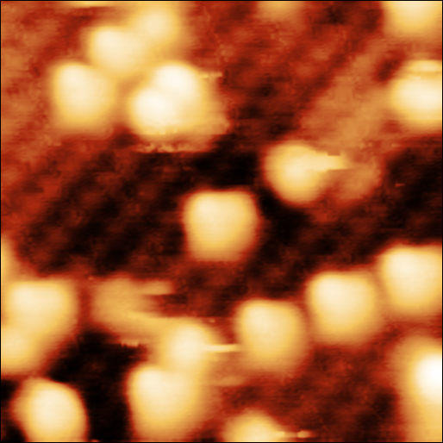
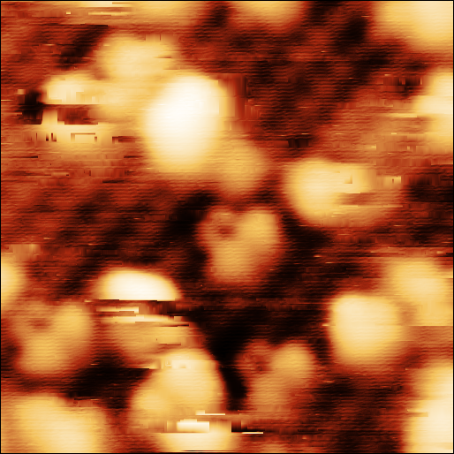
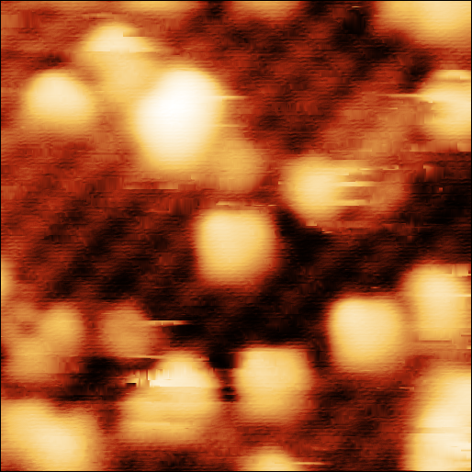
Another re-exposure
Across the rows
Before water exposure
Cherry
During water exposure
Nose
After water exposure

Slide 14
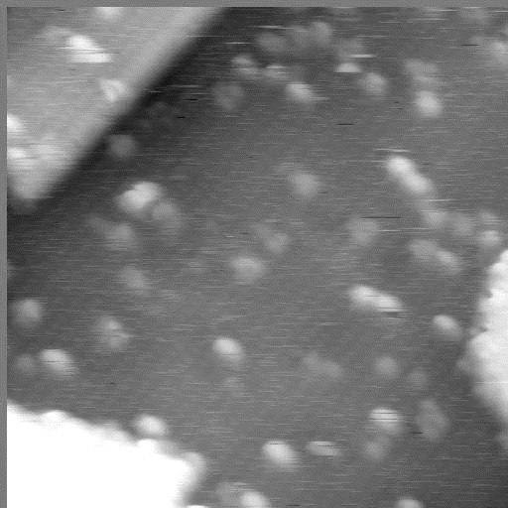
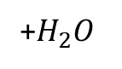
Reaction
+$H_{2}O$
$$VO_{2}+H_{2}O →VO_{3}H_{2}$$

Slide 15
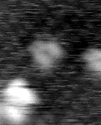
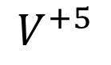
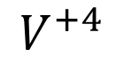
Moving feature could be a surface hydroxyl
Present under high water pressure
Formed after water pressure and stable under UHV
$$V^{+4}$$
$$V^{+5}$$
Reversible
20s per frame

Slide 16
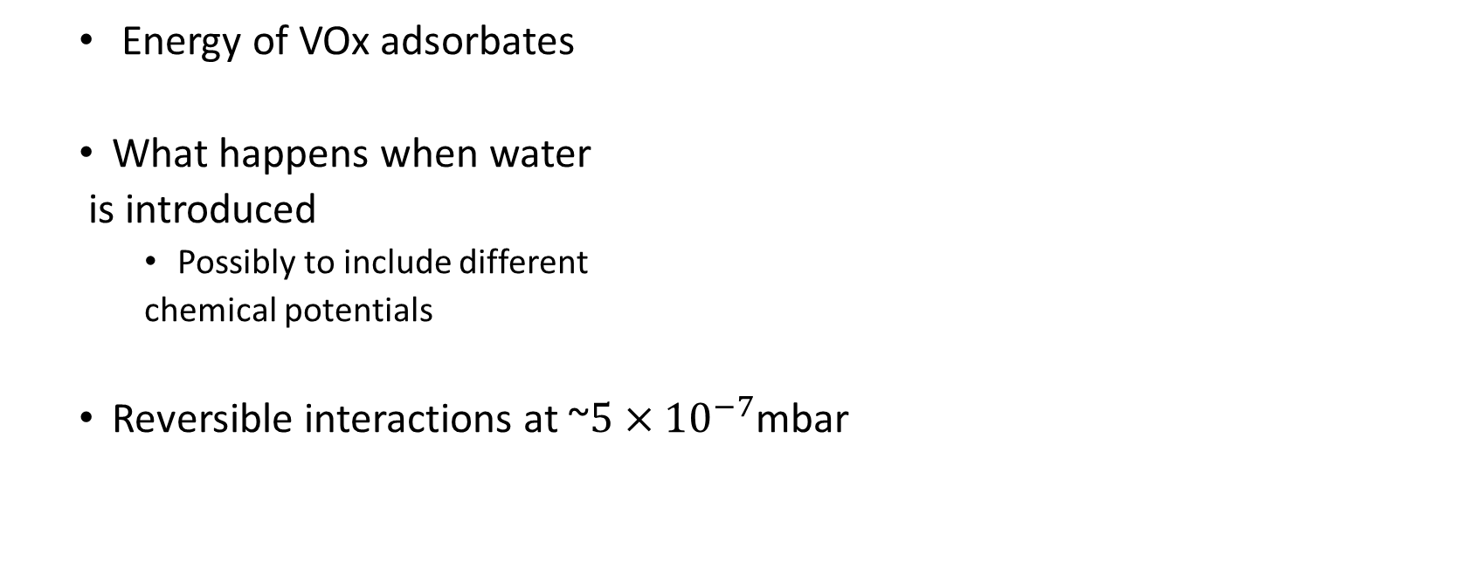
Calculations suggestions
Energy of VOx adsorbates
What happens when water
is introduced
Possibly to include different
chemical potentials
Reversible interactions at ~$5×{10}^{−7}$mbar

Slide 17
Planned experiments
- Higher coverages and slight annealing maybe during water exposure
- measure the amount of different species as function of H2O pressure.
- Low temp. water exposure
- Ammonia interaction
- eventually NO interaction

Slide 18
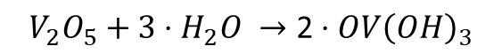
Vanadia dimers has been found to split under hydration
Most Stable
$$V_{2}O_{5}+3⋅H_{2}O →\text{2}⋅OV{\left(OH\right)}_{3}$$
DFT calculations on (001), not (101)
Calatayud, M., Mguig, B., & Minot, C. (2005). A DFT study on the hydrated V2O5-TiO 2-anatase catalyst: stability of monomeric species. Theoretical Chemistry Accounts, 114(1-3), 29-37.

Slide 19
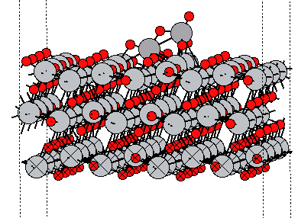
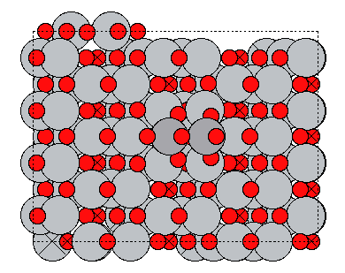
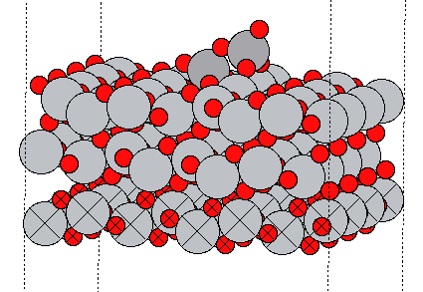
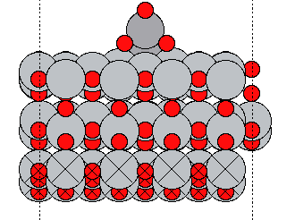
V₂O₅ cluster on TiO₂ surface Structure
Global minimum : V₂O₅_TiO₂(101)
Side view
Top view

Slide 20
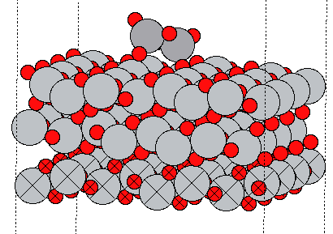
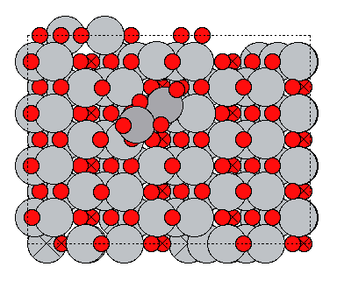
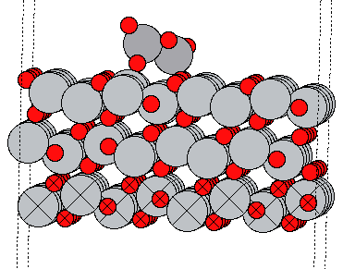
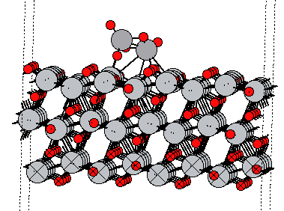
V₂O₅ cluster on TiO₂ surface Structure
Local minima 1: V₂O₅_TiO₂(101)

Slide 21
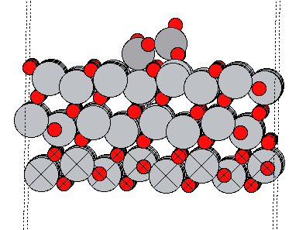
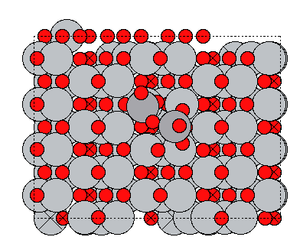
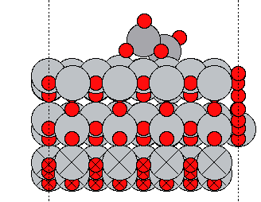
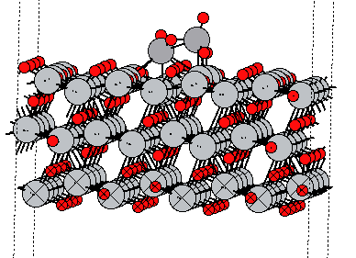
V₂O₅ cluster on TiO₂ surface Structure
Local minima 2: V₂O₅_TiO₂(101)

Slide 22



VO₂ on TiO₂ (101) Surface
Global minimum : VO₂_TiO₂(101)
Top view
Side view
Side view

